Slide 1


36. Irrigation Management System for Predicting Crop Water Requirements
Subtitle: Using matplotlib, seaborn and sklearn

Slide 2
Introduction
Water is the lifeline of agriculture. However, with climate change, population growth, and overuse of resources, managing irrigation efficiently has become more important than ever. Traditional irrigation practices often lead to over-watering or under-watering, which impacts crop health, reduces yield, and wastes water.
This project focuses on creating an intelligent irrigation management system using Python and data analysis to predict the exact water requirement of crops. It integrates weather data, soil moisture levels, crop stages, and machine learning to determine when and how much to irrigate.

Slide 3
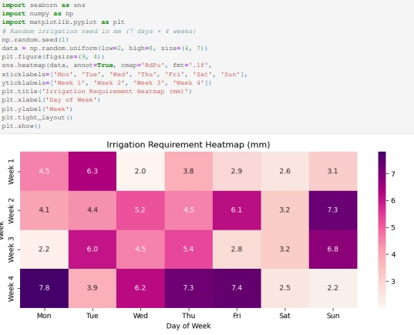
2. Problem Statement
Traditional irrigation systems (like flood irrigation) lead to:
Over-watering, which damages crops and leaches nutrients from the soil.
Under-watering, which reduces yield and causes crop failure.
Water wastage, especially in water-scarce regions.
Manual methods are inefficient, labor-intensive, and non-data-driven.

Slide 4
3. Objective
In this project, our goal is to build a smart, data-driven irrigation system. I will predict the daily water requirements for crops to reduce manual intervention and water wastage. The system will use real-world weather and environmental data to inform its decisions, supporting effective agricultural water management. I am also designing the system to be scalable and customizable, so it can be adapted for different crops and regions.

Slide 5
4. Key Concepts Involved
As a group, we are building an advanced irrigation system that calculates evapotranspiration (ET​) to monitor crop water needs. By utilizing real-world data such as temperature, humidity, and solar radiation, we can determine the exact amount of water lost from both the soil and the plant. To further refine our system, we have incorporated a Crop Coefficient (Kc​) to account for the unique characteristics of different crops and their various growth stages. Finally, our Irrigation Requirement Navigator (IR​) formula allows us to calculate the precise amount of water to apply by considering the difference between a crop's water needs (ET​) and the water provided by rainfall and any additional irrigation.

Slide 6
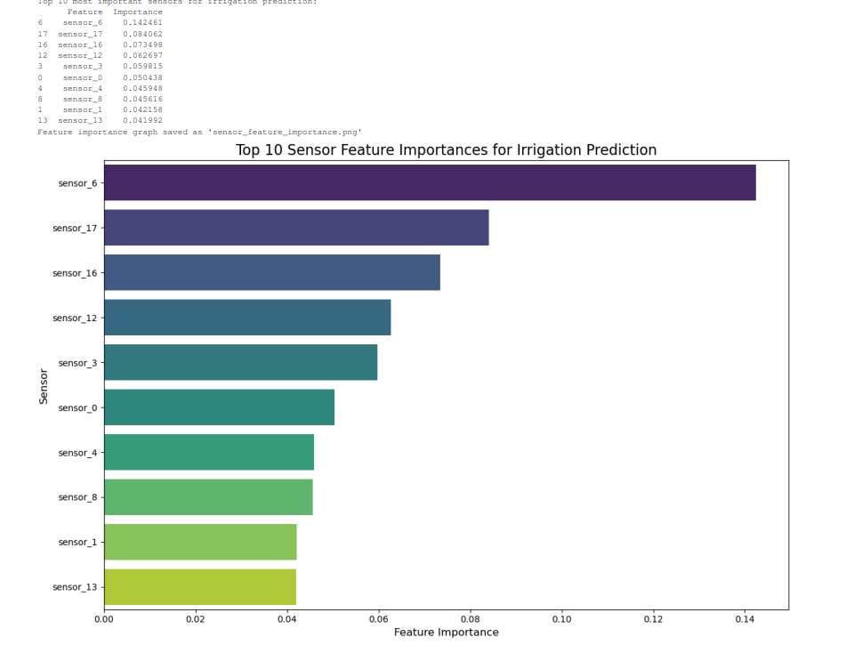

Slide 7
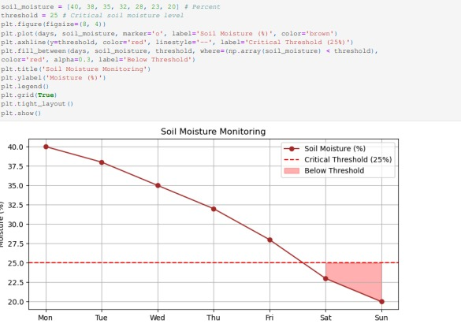
5.Traditional Vs Smart Irrigation
Traditional irrigation systems are manually controlled, often wasteful, and not efficient. They don’t respond to real-time weather or soil conditions. In contrast, smart irrigation uses automated controls based on sensor data and machine learning to deliver the exact amount of water needed. It’s more accurate, saves water, and ensures better crop health.

Slide 8
6. Weather & Environmental Parameters Used
The system uses the following input data:
Maximum and Minimum Temperature (°C)
Humidity (%)
Solar Radiation (MJ/m²/day)
Rainfall (mm/day)
Wind Speed (m/s)
Soil Moisture Level (%)
Crop Growth Stage
These parameters help calculate ET₀ and Etc, and ultimately help in predicting the water required.

Slide 9
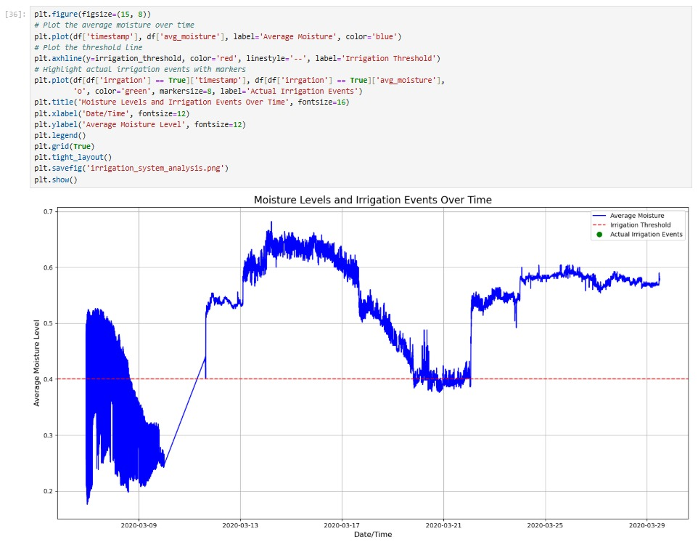

Slide 10
7. Intelligent Decision-Making Logic
This document outlines a methodology for a smart irrigation system developed as a student project. The system calculates crop water requirements by first determining reference evapotranspiration (ET0​) from weather data and then applying a crop-specific coefficient (Kc​) to find the actual crop evapotranspiration (ETc​). To prevent overwatering, the system calculates the net irrigation needed by subtracting rainfall from the ETc​ value. Irrigation is only triggered if real-time soil moisture levels drop below a set threshold. The system's final output is a simple, automated recommendation—"Irrigate Today" or "No Irrigation Needed"—to guide efficient and sustainable water management.

Slide 11
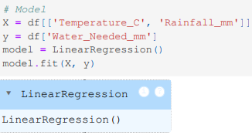
8. Machine Learning Integration
Objective: To enhance predictive accuracy using Machine Learning (ML).
Predictive Models: The system uses a Random Forest Regressor to predict the precise amount of water needed and a Random Forest Classifier to decide whether to irrigate.
Training Data: The ML models are trained on a combination of meteorological data (e.g., temperature, rainfall) and in-field sensor readings (e.g., soil moisture).
Outcome: This methodology leads to significant water conservation and improved crop health by ensuring the optimal amount of water is applied.
Adaptability: The ML framework is designed to be scalable and customizable, allowing it to be retrained and adapted for different crops and regional conditions.

Slide 12
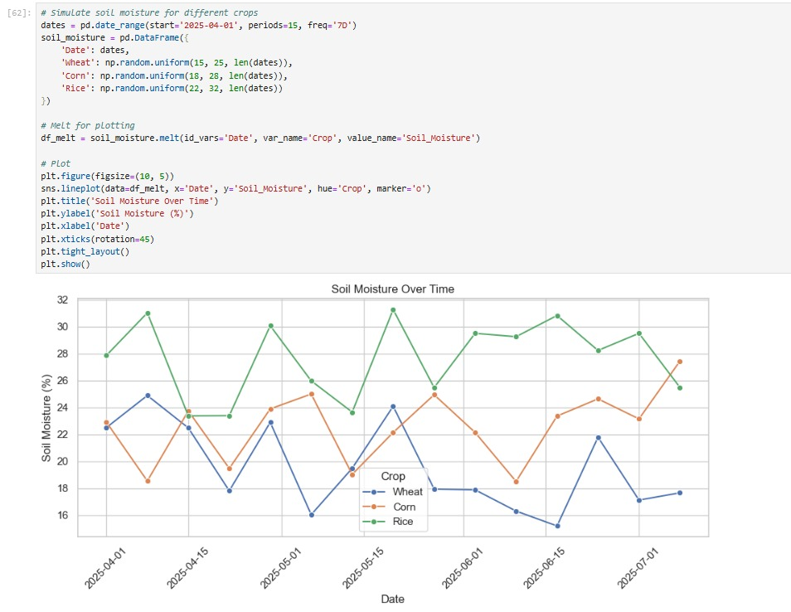
9. Real-Time Sensor Data Handling
In more advanced implementations, the system can be connected to real-time soil moisture sensors placed in the field. These sensors collect readings from multiple points (usually 5–10), and the system calculates the average moisture level. If the average value falls below a certain threshold (e.g., 25%), the system can trigger irrigation automatically. This real-time data integration makes the solution part of a broader smart farming or precision agriculture system using Internet of Things (IoT) technology.

Slide 13
10. Visualizations & Reporting
We are excited to showcase the complete architecture of our smart irrigation system. Our project is designed with a multi-layered approach to ensure robust and accurate performance. As the system's architecture is a multi-layered framework that starts with a comprehensive data collection phase, gathering real-time information from in-field sensors and external weather APIs. This data is then processed by an intelligent core that uses Machine Learning and custom algorithms to calculate crop water needs. Based on this analysis, the system's decision-making layer either provides a precise recommendation or automatically triggers the irrigation hardware, creating a fully autonomous and intelligent solution for efficient water management.

Slide 14
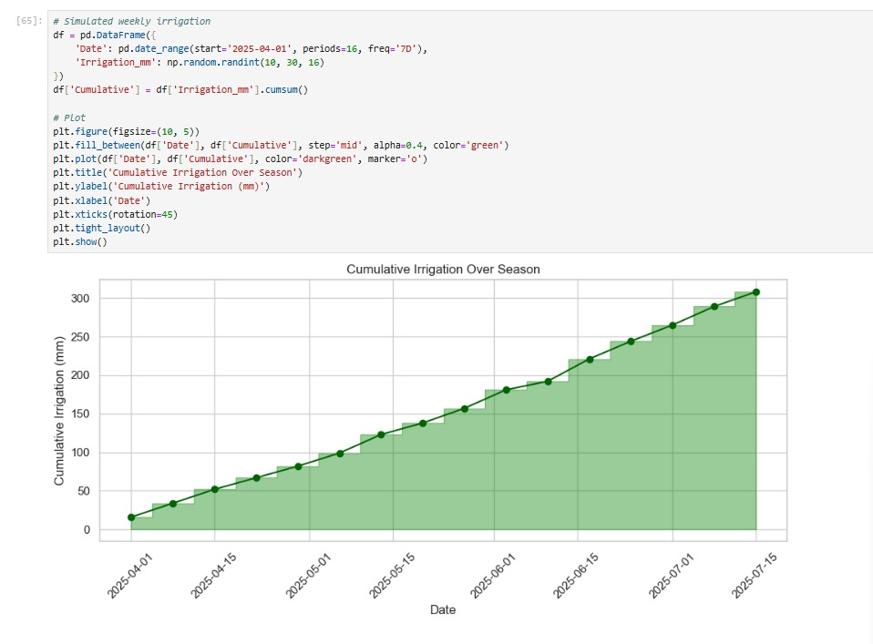

Slide 15
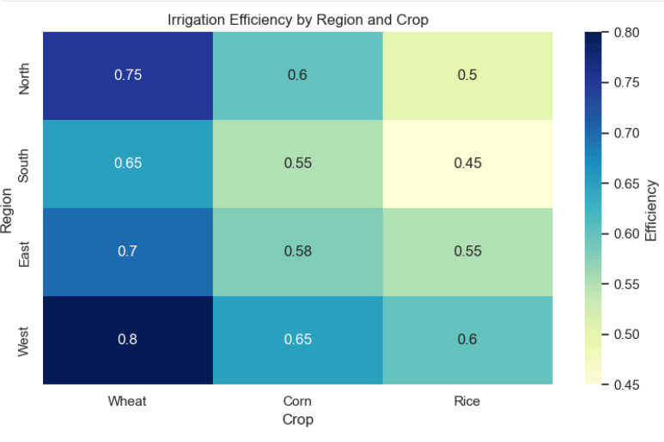
11. Our product's key benefits include:
Conserving Water: Reducing water consumption by 30-50% through precise, data-driven irrigation.
Improving Crop Yield: Increasing crop health and yield by ensuring plants receive the optimal amount of water.
Lowering Costs: Reducing operational expenses on water, energy, and manual labor.
Enhancing Sustainability: Promoting a more sustainable farming model by conserving a vital resource.
Simplifying Management: Providing effortless control through an automated system with a user-friendly interface.

Slide 16
12. What is Crop Water Requirement (CWR)?
Our project was designed to create a smart, data-driven irrigation system that improves upon traditional farming methods. The core of our methodology involves scientific principles such as calculating evapotranspiration (ET​) and integrating a dynamic Crop Coefficient (Kc​) to accurately determine a crop's water needs. We also developed an Irrigation Requirement Navigator (IR​) to factor in rainfall, ensuring we only apply the precise amount of water required.
The outcomes of our project are significant, including substantial water conservation, improved crop health, and reduced operational costs for farmers. Moving forward, our vision is to evolve this system into a comprehensive precision agriculture platform by integrating advanced AI and new data sources like satellite imagery. This will allow us to predict and manage a wider range of farming needs, creating a more sustainable and productive agricultural future.

Slide 17
13. Future Enhancements
The future of our product is to transform from a smart irrigation system into a comprehensive precision agriculture platform. This will involve integrating new data sources like satellite and drone imagery and using advanced AI to predict crop diseases and pest infestations in addition to water needs. The system will expand its IoT capabilities to connect with a wider range of farm equipment, acting as a central intelligent hub for the farm. The platform is designed to be scalable and customizable for different farm sizes, with the goal of creating a more productive and sustainable agricultural ecosystem.
Ultimately, our vision is to create a modular and scalable platform that is adaptable for any farm size, from small family operations to large enterprises. By building this intelligent and autonomous ecosystem, we aim to optimize every aspect of crop production and usher in a new era of sustainable and efficient farming.

Slide 18
14. Conclusion
We designed, planned, and produced a smart, data-driven irrigation system to optimize agricultural water management. Our methodology is based on scientific calculations like evapotranspiration and a Crop Coefficient to determine precise water needs. The system's core technology utilizes Machine Learning algorithms, trained on meteorological and sensor data, to predict water requirements and make autonomous irrigation decisions. This approach delivers significant benefits, including water conservation, increased crop yield, and reduced costs. Looking forward, we plan to evolve the system into a comprehensive precision agriculture platform by integrating advanced AI, new data sources like satellite imagery, and a wider range of IoT devices..

Slide 19
Research datasets and information:
Our group's project is a smart, data-driven irrigation system that combines scientific calculations with Machine Learning to optimize water usage. We designed the system to accurately determine a crop's water needs by using evapotranspiration and a crop-specific coefficient, while our Random Forest models predict the precise amount of water needed and make autonomous irrigation decisions. This intelligent system, trained on meteorological and sensor data, has delivered significant benefits, including water conservation and improved crop health. Our future vision is to evolve this product into a comprehensive precision agriculture platform by integrating advanced AI, new data sources, and a wider range of IoT devices.
Plant vase.csv
Weather data.csv
Crop Production
Irrigation Machine.csv

